Slide 1



Personality Development Workshop- 2 Days
Notes:
Note for the trainer: start the day with enthusiasm. Your enthusiasm should reflect in your tone of voice and body language.
Good morning everyone!
How are you today. Are you ready to dive into a day of learning, growth, and transformation? I know I am!
Today, we have a unique opportunity to learn from each other, challenge ourselves, and take our personal and professional lives to the next level. Today’s workshop is highly engaging, filled with activities, role plays, videos and discussions that are designed to inspire and empower you.
But this isn't going to be a passive experience. This isn't a lecture where you sit back and listen to someone else talk. This is an interactive, dynamic, and engaging workshop that requires your full participation, your curiosity, and your willingness to learn.
Throughout the day, you'll have the chance to connect with other like-minded individuals, share your own experiences and insights, and gain new skills and knowledge that will help you achieve your goals. You'll be challenged, pushed outside your comfort zone, and supported every step of the way.
So, are you ready to embrace this day with open hearts and open minds? Are you ready to learn, grow, and transform? I know I am, and I can't wait to see what we'll achieve together.
Let's get started!

Slide 2
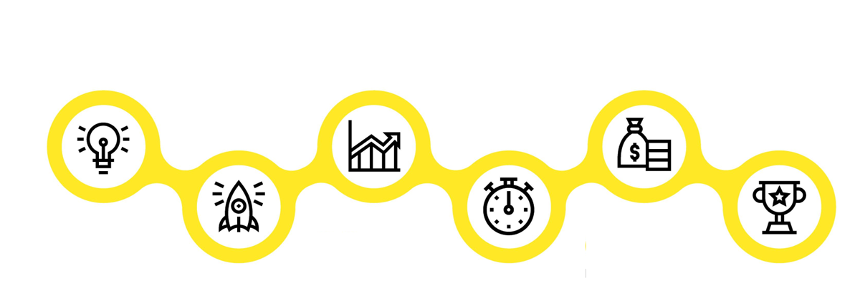






Agenda of Workshop- Day 1
Components of Personality Development
Module 1
Module 3
Module 5
Understanding Personality
Development
Impactful
Communication
Goal Setting
Module 2
Module 4
Module 6
Building an Attitude
of Ownership
Building a Fool Proof Communication
Being a Team Player
Notes:
The agenda of todays workshop is as follows
Understanding Personality Development
Building an attitude of Ownership at workplace
Impactful communication
Building Fool Proof Communication
Goal Setting
Being a Team player

Slide 3
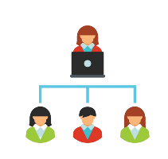


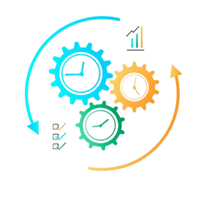

Components of Personality Development
Module 1
Module 3
Module 5
Managing Stakeholders
First Impression is the last Impression
Email etiquette
Module 2
Module 4
Recap/Revision
Manging Time & Prioritisation
First Impression is the last Impression Part-2
Agenda of Workshop- Day 2
Notes:
The agenda of todays workshop is as follows
Managing Stakeholders
Managing Time & Prioristising
First Impression is the Last Impression-Part-1
First Impression is the Last Impression-Part-2
Email Etiquettes
Recap

Slide 4


Personality Development
Process of enhancing and refining various aspects of an individual's personality, behavior, attitudes, and characteristics.
It involves both self-awareness and intentional efforts to improve oneself in order to achieve personal growth, success, and a better quality of life.
Notes:
Personality refers to a unique set of traits, behaviors, attitudes, and characteristics that collectively define an individual's distinctive pattern of thinking, feeling, and behaving. It encompasses a person's typical ways of responding to various situations, interacting with others, and expressing themselves. Personality is an integral aspect of an individual's identity and influences how they perceive the world, make decisions, and engage with their environment.
Personality development refers to the process of enhancing and refining various aspects of an individual's personality, behavior, attitudes, and characteristics. It involves both self-awareness and intentional efforts to improve oneself in order to achieve personal growth, success, and a better quality of life. Personality development encompasses a wide range of factors that collectively contribute to an individual's overall demeanor, interactions with others, and effectiveness in various life domains.

Slide 5

Myths Vs Facts of Personality Development
Personality is fixed and unchangeable.
While personality traits do exhibit stability, they can also change and adapt over time due to personal growth, experiences, and intentional efforts towards self-improvement.
Personality development is only for young people.
Personality development is a lifelong process. Individuals of all ages can continue to enhance their traits, behaviors, and attitudes, leading to personal growth and improved quality of life.
Personality development means changing who you are completely.
Personality development is about enhancing existing traits, refining behaviors, and becoming the best version of oneself. It doesn't necessarily require a complete overhaul of who you are.
Personality development is only about external presentation.
Personality development encompasses both internal and external aspects. While improving social skills is a part of it, it also involves self-awareness, emotional intelligence, and authentic self-expression.
Personality development is a quick fix.
Personality development is a gradual and ongoing process that requires time, effort, and consistency. It involves building new habits, fostering self-awareness, and adapting to changes over time.
Notes:
Personality is Fixed and Unchangeable:
Myth: Some people believe that personality traits are fixed and unchangeable, determined solely by genetics and early life experiences.
Reality: While personality traits do exhibit stability, they can also change and adapt over time due to personal growth, experiences, and intentional efforts towards self-improvement.
2. Personality Development is Only for Young People:
Myth: It's often assumed that personality development is primarily relevant for young individuals and that personality traits become more rigid as people age.
Reality: Personality development is a lifelong process. Individuals of all ages can continue to enhance their traits, behaviors, and attitudes, leading to personal growth and improved quality of life.
3. Personality Development Means Changing Who You Are Completely:
Myth: Some believe that personality development involves completely transforming one's core identity and characteristics.
Reality: Personality development is about enhancing existing traits, refining behaviors, and becoming the best version of oneself. It doesn't necessarily require a complete overhaul of who you are.
4. Personality Development is Only About External Presentation:
Myth: There's a misconception that personality development is solely about improving external appearances and social skills.
Reality: Personality development encompasses both internal and external aspects. While improving social skills is a part of it, it also involves self-awareness, emotional intelligence, and authentic self-expression.
5. Personality Development is a Quick Fix:
Myth: Some believe that personality development can lead to instant and dramatic changes in one's personality and life circumstances.
Reality: Personality development is a gradual and ongoing process that requires time, effort, and consistency. It involves building new habits, fostering self-awareness, and adapting to changes over time.
Dispelling these myths is crucial to understanding that personality development is a nuanced and continuous journey. It involves enhancing existing traits, adapting to new experiences, and becoming more self-aware, ultimately leading to personal growth and a more fulfilling life.

Slide 6
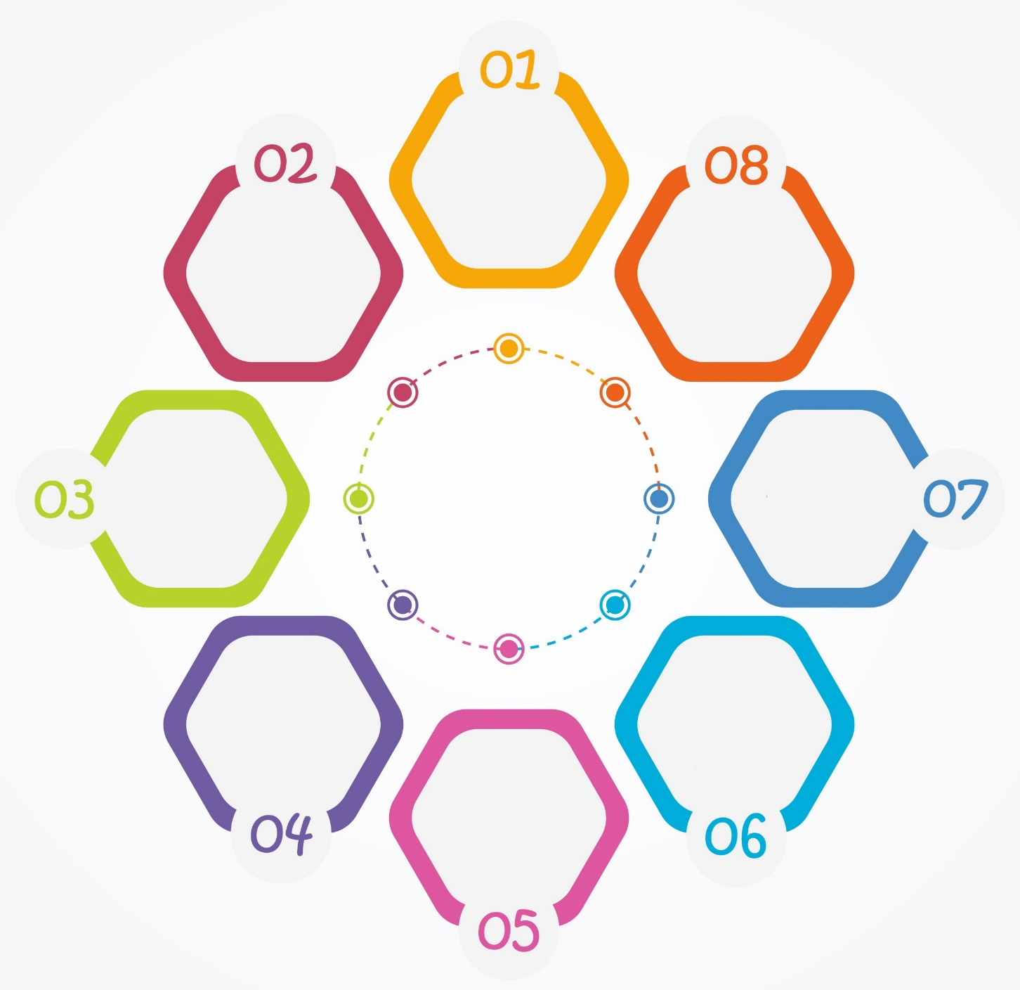


Benefits of Personality Development- Individual
Enhanced
Self-Confidence
Improved Relationships
Positive Reputation
Career Growth
Better Decision Making
Effective Communication
Adaptability
Work Life
Balance & Stress Management
Notes:
Enhanced Self-Confidence: Personality development cultivates self-confidence, allowing individuals to tackle challenges with self-assuredness and a positive attitude.
Improved Relationships: Strengthened interpersonal and communication skills lead to better relationships with colleagues, friends, family, and peers.
Career Growth: Developing strong interpersonal and leadership skills can open doors to career advancement and opportunities for professional growth.
Effective Communication: Improved communication skills enable individuals to express themselves clearly, minimizing misunderstandings and enhancing their overall impact.
Work Life Balance & Stress Management: Enhanced emotional intelligence and time management skills contribute to better stress management, leading to improved overall well-being.
Adaptability: Personality development fosters adaptability, allowing individuals to navigate changes and uncertainties with greater ease.
Better Decision-Making: Improved self-awareness and critical thinking skills lead to more informed and effective decision-making.
Positive Reputation: A well-developed personality earns respect and a positive reputation among peers and colleagues.

Slide 7



Achieving Personal Excellence
Attitude
Skills
Knowledge
Notes:
To achieve personal excellence any professional needs to sharpen (ASK) i.e Attitude, Skills & Knowledge
Attitude: Attitude refers to a person's mindset or perspective. A positive attitude can help individuals overcome obstacles, maintain focus, and stay motivated in the face of challenges. Personal effectiveness requires a positive attitude that is characterized by resilience, self-confidence, and a growth mindset. Without a positive attitude, it can be difficult to achieve personal goals and objectives.
Skills: Skills are the abilities and competencies that individuals possess to perform specific tasks or activities. In order to be personally effective, individuals must possess a range of skills, including communication, problem-solving, time management, leadership, and teamwork. Developing these skills can help individuals to better manage their personal and professional lives and achieve their goals.
Knowledge: Knowledge refers to the understanding and awareness that individuals have of themselves, others, and the world around them. Personal effectiveness requires individuals to have a strong knowledge base in areas such as self-awareness, emotional intelligence, critical thinking, and decision-making. This knowledge can help individuals make informed choices, build strong relationships, and achieve personal and professional success.
In summary, a combination of a positive attitude, strong skills, and relevant knowledge is essential for personal effectiveness. Individuals who possess these qualities are better equipped to overcome challenges, achieve their goals, and make a positive impact in their personal and professional lives.

Slide 8

What is Attitude?
The way a person thinks or feels about a specific person, place, action or experience.
Notes:
Ask: What is attitude?
Elicit response.
Say: Attitude is the way a person thinks or feels about a specific person, place, action, or experience. Similar to the individual perspective, attitude encompasses the individual’s particular emotions and the way in which they act towards people and work. Attitude is a specific disposition that combines factors like beliefs, opinions, moods, and emotions. Sometimes, attitude is referred to as an outlook or mental state that affects the way people perceive the world around them and the way they experience life, work, relationships, and more.
Ask: Why is positive attitude so important for professional excellence?
Transition to the next slide.

Slide 9

Why is having a Positive Attitude Important for a Professional
Boosts productivity
Reduces stress
Supports learning
Improves problem-solving
Increases confidence
Increases resilience
Helps you manage conflict
Notes:
Our attitude is directly responsible for our behavior. More wholesome our attitude, the more empowered our conduct.
With a positive attitude, you can improve your emotional well-being and self-image. It is a powerful tool for personal growth and professional excellence.
The power of a positive attitude in the workplace has been proven to:
Boost productivity
Reduce stress
Support learning
Improve problem-solving
Increase confidence
Increase resiliency
Help manage conflict
A positive attitude could also be regarded as one that is oriented toward finding what is best about a given situation or environment and then building on that.
While many factors are responsible to propel a wholesome professional attitude, we will be discussing four key ones today:
Taking ownership and accountability at work
Having a solution-centric approach
Avoiding blame game
Operating from one’s circle of control.
Transition to the next slide.

Slide 10

To take Ownership Operate from
Circle of Control
Notes:
Read this line Loudly- - To take Ownership Operate from Circle of Control
Lets see what is circle of Control- Transition to next slide

Slide 11

Having a Solution-Centric Approach
Solution-oriented people always find a way.
Solution-oriented people use critical thinking.
Solution-oriented people answer the ‘why’ question.
Notes:
Say:
Someone with a solution-centric mindset approaches work with a focus on honing in on solutions and forward progress. They don’t get stuck in setbacks or drama. Instead, they learn from setbacks and move forward. They don’t ignore or push problems aside. Instead, they voice problems with a proposed solution and align the team around a plan of resolution and execution. They make sure they (or someone on the team) close the loop in implementing the solution.
A solution-centric mindset is at the heart of making progress for a professional. It is not necessarily inherent; it usually comes from past experience and it can be taught and adopted.
Being solution-oriented means you will meditate to fix the problem. Solution-oriented people don’t just solve problems, they help identify the source of a question or challenge and provide the right or a better, way of doing things. Additionally, one of the greatest strengths of a solution-oriented individual is their ability to think critically. This requires the ability to think, evaluate, analyze, and decide clearly and quickly, in such a way that helps solve a problem. Lastly, solution-oriented people funnel all decisions through a filter that helps answer ‘why’. This unique approach immediately gets to the heart of the matter, or the individual, where the roots help clarify the situation or question.
Transition to the next slide.

Slide 12

Avoid Blame Game
Why is it played?
Avoid Responsibility
Protect Reputation
Signs of the Blame Game
Finger Pointing
Denial
Notes:
Say:
Picture a classroom where students are working on a group project. The deadline is approaching, but they’re far from finished and the teacher is enquiring about the status of the project.
As the students start to explain themselves, “the blame game” begins. Everyone starts to point fingers at each other and the discussion goes around in circles as they try to avoid the blame and pin it on someone else.
Does this situation seem familiar? Have you experienced something similar, at work perhaps?
Why do people play the blame game?
These are some reasons why people play the blame game:
1. To avoid Responsibility: People feel that if something goes wrong and they own it, they will be held responsible. They try to avoid this responsibility by shifting the blame onto someone else. This is the best way to defend and safeguard themselves.
2. Protect Their Reputation: People tend to play the blame game when they fear that owning their mistakes could negatively impact the way they are perceived.
These people tend to be insecure about their identities and fear that small missteps could become global reflections of who they are, or that they could face catastrophic consequences, like being demoted or fired.
Signs of the Blame Game
Sometimes it can be quite evident that someone is trying to shirk responsibility. Other times, it could be more subtle.
Here are some indications that someone is playing the blame game:
Finger-pointing: People may point fingers at others. For instance, they may say “He was supposed to send me the data for the presentation. I couldn’t make it without that information.”
Denial: People may deny their responsibility. For instance, they may say “No one told me we needed to include graphs in the presentation, how was I supposed to know?”
Transition to the next slide.

Slide 13

Aggressive Communication
Involves being forceful, confrontational, and often disregards the feelings or needs of the other party. It can come off as rude, demanding, and hostile.
Example 1: Disregarding Others' Opinions "Your ideas are always ridiculous. I can't believe you even bother to contribute."
Example 2: Insulting or Blaming "You're so incompetent; nothing you do is ever right."
Example 3: Interrupting and Dominating the Conversation "Let me finish! You clearly have no clue what you're talking about."
Notes:
Involves being forceful, confrontational, and often disregards the feelings or needs of the other party. It can come off as rude, demanding, and hostile.
Example 1: Disregarding Others' Opinions "Your ideas are always ridiculous. I can't believe you even bother to contribute.“
Example 2: Insulting or Blaming "You're so incompetent; nothing you do is ever right.“
Example 3: Interrupting and Dominating the Conversation "Let me finish! You clearly have no clue what you're talking about."

Slide 14
Types of Communication
Communication
Assertive
Aggressive
Passive
Empathetic
Notes:
Say: Communication can further be categorized into 4 types:
Assertive
Aggressive
Passive and
Empathetic
So what are these?

Slide 15
Aggressive Communication
Shouting
Yelling
Demanding
Commanding
Blaming
Being critical
Being verbally abusive
Notes:
These are considered as the signs of Aggressive communication
When different participants in the communicative process use aggressive communication, the exchange of information tends to be based on reproaches and pre-established ideas on an individual basis. Thus, aggressive communication does not usually achieve the objectives of communicative processes, since there is no bidirectional exchange in its activity.
On the contrary, this type of communication is usually used to transmit authority, demand or superiority over the other.
Aggressive communication does not stop with words; it can also be a nonverbal communication such as facial expressions, tone of voice, and body language. Here are a few examples of aggressive communication:
Criticism of others
Use of humiliation to control others
Attempts to dominate
Frequent interruptions
Easily irritated temper

Slide 16
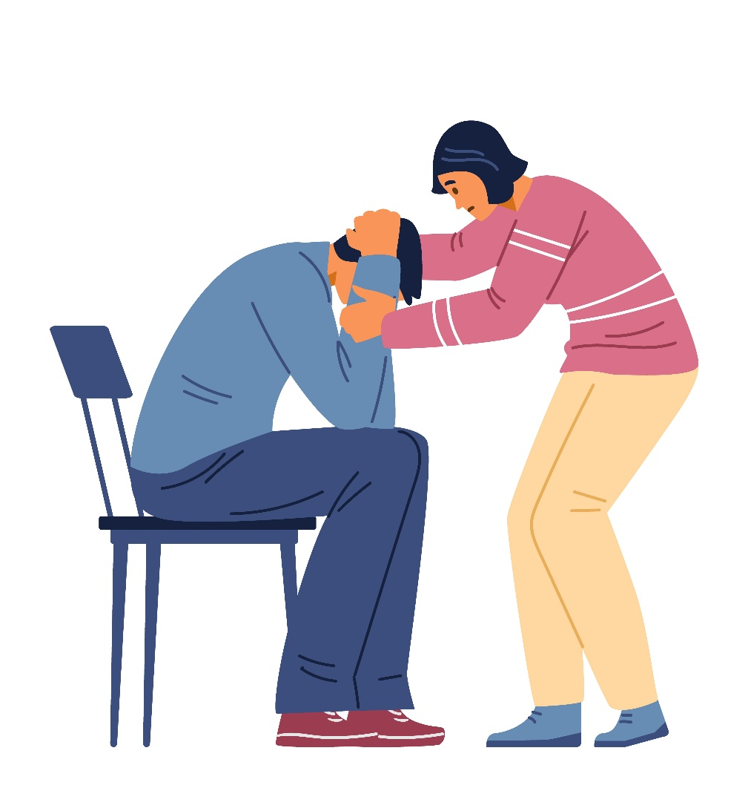
Empathetic Communication
You're making total sense.
I understand how you feel.
You must feel so hopeless.
I just feel such despair in you when you talk about this.
You're in a tough spot here.
I can feel the pain you feel.
The world needs to stop when you're in this much pain.
I wish you didn't have to go through that.
Notes:
Say: You’ll be amazed at how much of an impact even a simple empathetic statement can make. Here are some of empathy statements to have handy at all times.
You're making total sense.
I understand how you feel.
You must feel so hopeless.
I just feel such despair in you when you talk about this.
You're in a tough spot here.
I can feel the pain you feel.
The world needs to stop when you're in this much pain.
I wish you didn't have to go through that.

Slide 17

Way to Tackle Passive Communicator
Try To Initiate A One-On-One Interaction
Give Them Enough Time To Think Through Their Response after Asking question
Avoid Asking Yes/No Questions
Notes:
Say: If you encounter a passive speaker, consider using these techniques to effectively communicate with them:
Try To Initiate A One-On-One Interaction To Build Rapport. Passive Speakers Are More Comfortable With Personal Interactions Than Group Discussions.
Give Them Enough Time To Think Through Their Response When You Ask Them A Question.
Avoid Asking Yes/No Questions; Instead, Pose Open-Ended Questions That Encourage Them To Provide An In-Depth Response.
Conclusion
Passive communication doesn’t make you a bad person or a failure. However, it can hold you back and limit your opportunities—making it difficult for you to achieve your goals and objectives. Harappa Education’s Speaking Effectively course will teach you how to speak confidently. The PAM (Purpose, Audience and Message) Framework will help you identify and employ the different components of fruitful communication. The Non-Verbal Cues framework will teach you how to use your facial expression and body language to support your words. Be the speaker who stands out and leaves a lasting impression on people!

Slide 18




Fool Proofing Communication – LADR Approach
Listen Actively
Ask Effective Questions
Doubts should be Clarified
Reconfirm before proceeding
Notes:
Say: So what is LADR?
L for Listening actively:
A for Ask Questions:
D for Doubts Clarify:
R for Reconfirm before proceeding:

Slide 19

What is a Goal?
A goal is a specific and measurable objective or target that an individual , department or organization aims to achieve within a set period of time.
Notes:
A goal is a specific and measurable objective or target that an individual or organization aims to achieve within a set period of time. Goals can be short-term or long-term and can be related to various aspects of life such as personal, professional, academic, or health-related goals.
Goals can help individuals to break down larger objectives into smaller, more manageable tasks and track progress towards their desired outcome.

Slide 20
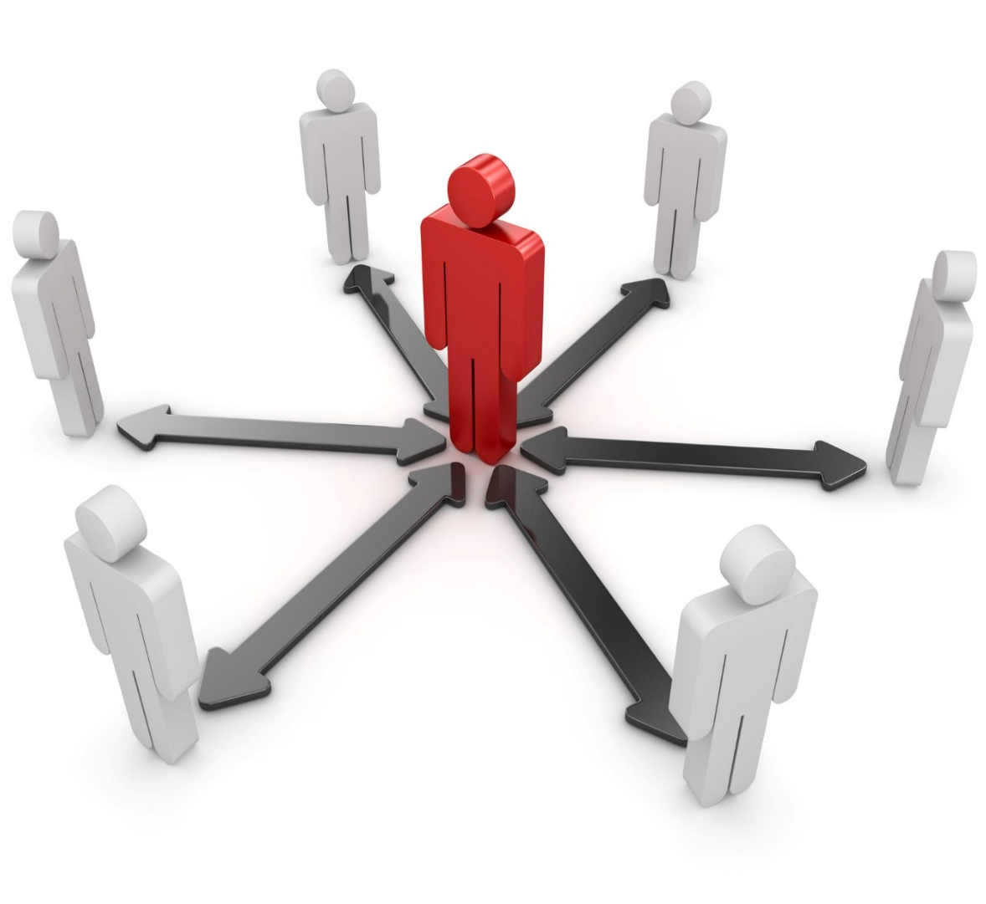
What is Interpersonal Effectiveness ?
The ability to understand, communicate and interact with other people in a way that leads to productive working relationships and enables the achievement of desired outcomes for you, your team and the organization.
Notes:
Interpersonal effectiveness refers to the ability to communicate and interact with others in a way that is respectful, assertive, and responsive to the needs of both oneself and others. It involves the skills of effective listening, expressing oneself clearly and assertively, understanding and respecting others' perspectives, negotiating conflicts, and managing emotions in relationships.

Slide 21






Thanks for Participation
98752-08472
Hello@freelancetrainings.com
www.freelancetrainings.com
406, Titanium City Centre Mall, Anand Nagar, Satellite, Ahmedabad-380015

