Slide 1


Ownership & Accountability Workshop
Your
Company
Logo
Notes:
Facilitator’s Notes:
Welcome the participants to the training session on Ownership & Accountability
Welcome to the workshop on Ownership & Accountability. This workshop will provide an overview of the importance of ownership and accountability in the workplace, and the benefits of implementing these principles. We will discuss the different aspects of ownership and accountability, including taking responsibility for one’s actions and decisions, owning up to mistakes, and striving for excellence. We will also explore practical strategies for creating a culture of ownership and accountability in the workplace. Finally, we will discuss the implications of these principles and how they can help organizations achieve their goals. By the end of this workshop, participants will have a better understanding of ownership and accountability and the positive impact it can have on their organization.
So sit back relax and be ready to experience this workshop

Slide 2

Agenda
Module No. | Topic
Module 1 | What it means to take ownership and accountability
Module 2 | Understand the importance of taking ownership and accountability
Module 3 | Work to a structure that helps you identify opportunities for exercising ownership and accountability
Module 4 | Key stages of accountability cycle
Module 5 | Learn the lessons of unsuccessful outcome and develop a plan to overcome it
Module 6 | Personal strength analysis
Notes:
Facilitator’s Notes:
Tell: The agenda of the today’s training is to learn:
Module 1 What it means to take ownership and accountability
Module 2 Understand the importance of taking ownership and accountability
Module 3 Work to A structure that helps you identify opportunities for exercising ownership and accountability
Module 4 Key stages of accountability cycle
Module 5 Learn the lessons of unsuccessful outcome and develop a plan to overcome it
Module 6 Personal strength analysis
Course Objective
Participants will be able to take accountability and ownership of his decisions and actions
Stop blame game
Improved ‘can-do’ attitude
Improve employee engagement level
Improve productivity
Cordial interpersonal relations at workplace

Slide 3
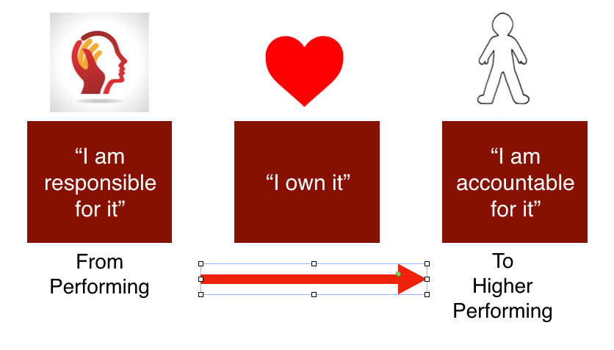
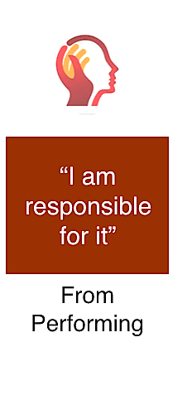
Ownership & Accountability
Taking ownership is accepting responsibility for actions and ownership of outcomes.
You take accountability for your ideas, tasks, decisions, objectives, and choices at work thus acting like a solution centric professional.
Notes:
Taking responsibility for your actions: Actions speak louder than words and are even more vital in the workplace. If things go wrong and someone needs to be held accountable, don’t blame others for saying they told you to do it. Own up to your mistakes with no excuses — this will help others become accountable for their actions moving forward.
Testing your skills and abilities: Many people have great ideas, but nothing will happen if you don’t act on them. Without thinking of new ways to improve something, there will not be any progress. People who take ownership are always trying to make things better, even if it puts them at risk. They are willing to face the consequences of their actions head-on without fear of being judged. If you have a good idea, say it and see what happens or go out on your own if need be. Making suggestions that stretch beyond your job role is a great way to take ownership. A professional who takes ownership and accountability is a solution centric professional.
So who is a Solution Centric Professional. Note: Elicit a few responses & then show the slide.

Slide 4

A solution centric professional is one who…
Finds ways to do stuff without saying No.
Doesn’t get distracted by minor failures.
Is persistent and optimistic in finding solutions in spite of failures to make things happen.
Has the ability to handle frustrations, pressure and challenges.
Goes the extra mile when required.
Notes:
Say: A solution centric Professional is one who..
Finds ways to do stuff without saying No- Most of us hesitate to take up work just because we feel we may not be able to complete it or have other work which is on priority. A solution centric professional is one who readily accepts any activity or task given to him/her without any hesitations or preconceived notions.
Doesn’t get distracted by minor failures - A solution centric professional will not stray away from completing the task, even if he/she encounters failures on his path. Nothing would deter him from completing the task on hand.
Is persistent and optimistic - Even if he/she encounters failures in the process of completing an activity, he will still continue to be determined about completing it. If one way of completing the task doesn’t work out, he would improvise and come up with another way of completing the task.
Has the ability to handle frustrations, pressure and challenges - Just like failures do not deter the solution centric professional from completing the task on hand, not even frustrations, pressure and challenges would affect him. Most of us can’t handle pressure or get discouraged by challenges. A solution centric professional will remain calm and composed in times of pressure and still yield results.
Goes the extra mile - A solution centric professional knows that he will find a solution to a problem if he/she goes the extra mile. They won’t shy away from putting in that additional amount of effort, when required.
Note: Trainer can add their own set of experiences to customise this slide to any department, industry, etc.

Slide 5
Area’s to Build Ownership & Accountability
Mindset
Building the right mindset
People
Key Stakeholders
Performance
Work & Team related
Task
Your Tasks and activities
Notes:
Any professional can think of Ownership in 4 broad areas to achieve a superb performance and productivity. These areas are
Mindset- Building Self Mindset
People- Line Manager, Manager
Task- Daily tasks, activities and deliverables
Performance – Work & Team related
Lets Look at the same in detail in the next slide

Slide 6
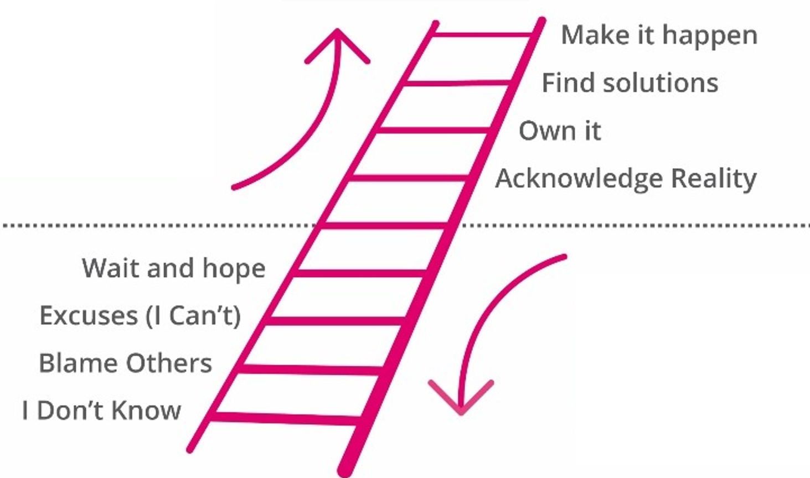
Accountability Ladder Decision Path - Victim Vs Accountable
Where do you stand?
Up the ladder or down?
Accountable Behaviours
Things happen because of you
recognize, own, self-examine, learn & take action
Victim Behaviours
Things happen to you
Ignore, deny, blame, resist & hide
Notes:
Tell: You typically find 3 kinds of people in the workplace:
Those who make things happen
Those who watch things happen
And those who wonder what happened!
What will any of these statements do to solve the problem? … Nothing
How often do we look inside and ask ourselves,
'What could I have done to make that situation better?' The answer is… all too often… Never!

Slide 7








Accountability Pathways
Unaccountable
Not Aware
Blame Others
Making Excuses
Waiting & Hoping
(Victim Mentality)- Finds excuses and runs away from actions
Accountable
Acknowledges Reality
Self action commitment
Solution Centric
Make it Happen
(Winner Mentality)- Finds ways to do action.
Notes:
Facilitator’s Notes:
Explanation on Accountability Pathways :
The Accountability Pathway graphically presents the different choices we make after we commit to do something.
Keep the following in mind as you think about the Accountability Pathway:
Accountability is developmental. You can be at different stages along the Pathway at work.
Discussing accountability feels uncomfortable. However, you can explore the sources of your discomfort and use those insights to become better at making and keeping commitments.
Using the Accountability Pathway can minimize your and others’ frustration when you struggle to keep commitments, or are un-productively critical of yourself and others, and/or get stuck because no progress is being made but the topic is avoided and not discussed.
The process can lead to discoveries about how to make and keep commitments that move your from talk to actions that produce the desired results – the results that make things better for you and others.

Slide 8
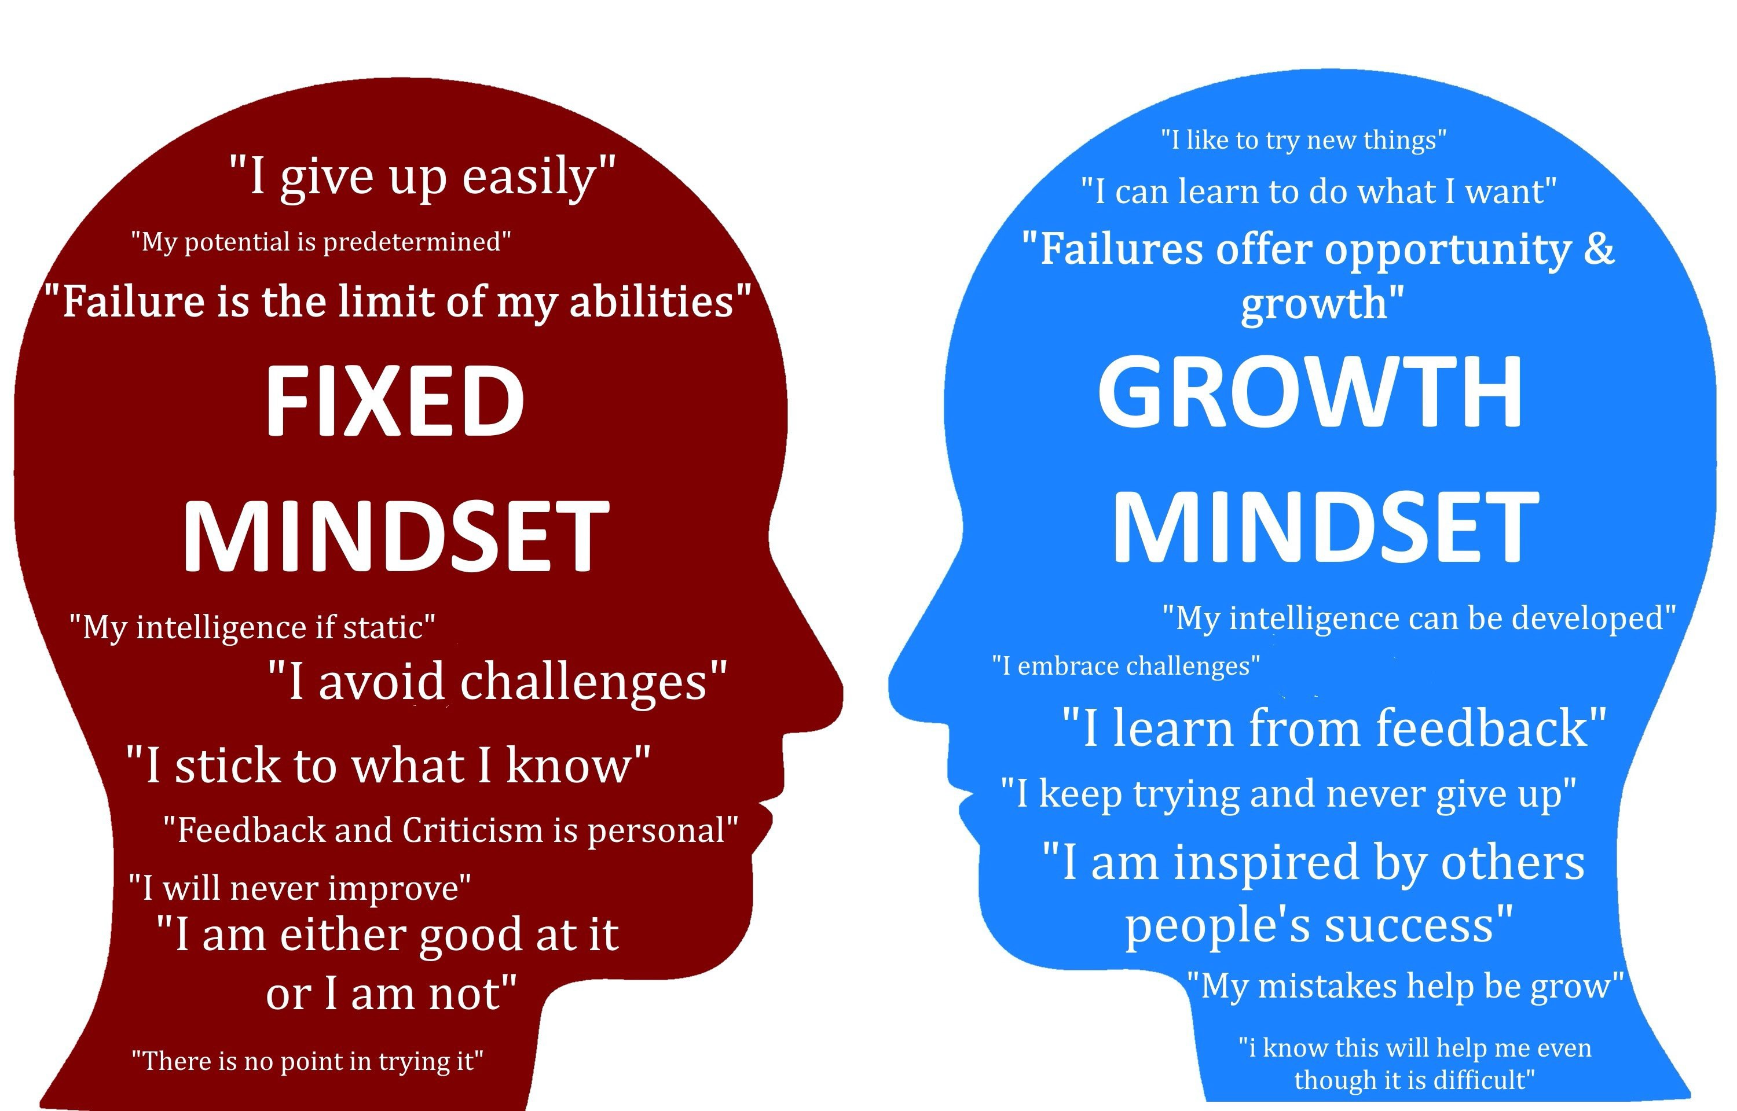
Notes:
Facilitator’s Notes:
Say: A fixed mindset is the idea that our intelligence, character, and creativity are innate and mostly unchangeable.
A growth mindset sees gaps in our knowledge or skills as chances for growth. With a growth mindset, you’re open to improvement and believe you can only get better and smarter, which are attractive qualities in the workplace.
Explanation:
People with a fixed mindset:
Believe that intelligence is static and each person has an inherent level of ability
Focus on ‘looking smart’ and limit themselves to things they know they can do well
Avoid challenges, since failing would negatively impact their self-image
Hate unexpected obstacles – challenges they have to face, where success is not assured
See effort as ultimately pointless, since they simply ‘are who they are’
Ignore or take very personally criticism
Feel threatened by the success of others
People with a growth mindset:
Believe that intelligence can be developed, which sparks their desire to learn and improve
Failure is just another opportunity to learn
Embrace challenges
Obstacles do not discourage them
See effort as necessary to grow and master new skills
Consider criticism and negative feedback as sources of valuable information
Find lessons and inspiration in the success of others
Ask: What kind of mindset do you have?
Say: Here are some more ways to spot the differences between a fixed mindset and a growth mindset.
And then give the handout named ‘Handout Module 3.1 Mindset’.

Slide 9
Opportunities for Exercising Ownership & Accountability
See It
Observe, recognize opportunity available to learn, practice and support. Take initiative.
Own It
Take ownership and responsibility to learn & complete the assigned task within deadline. Know and work with the expectations.
Solve It
How would you want to complete the task? What are your options? Who can support? Whom do you have to keep informed?
Do It
Fulfill the commitment & follow through with the solutions identified. Deliver result.
Cover your trail
Blame, point finger at others
Its not my job!
Ignore/ Deny
Wait for instructions.
Tell me what to do
Notes:
Facilitator’s Notes:
Tell: Let’ learn the what should you do to exercise ownership & accountability?
Say:
Step 1: See It - Observe, recognize opportunity available to learn, practice and support. Take initiative.. You must see the reality of where you are. You must be willing to recognize that you are engaging in behaviors that are not helping you move ahead in whatever you do.
Step 2: Own It - Take ownership and responsibility to learn & complete the assigned task within deadline. Know and work with the expectations. You must accept full responsibility of all past and present behavior that has contributed to current circumstances. We all have a part to play in why we are where we are.
Step 3: Solve It - How would you want to complete the task? What are your options? Who can support? Whom do you have to keep informed? Solving means solving real problems not tackling imaginary ones. We can do this by constantly asking, ’What else can I do to get the results I want’. Solving it is not an extra activity, it is part of the job.
Step 4: Do It - Fulfill the commitment & follow through with the solutions identified. Deliver result. Embracing your full responsibility for results and remaining answerable for your progress in attaining those results, regardless of how and why you managed to get into your current situation
Lets Move to the next slide.

Slide 10





Accountability Cycle
Step 1. Set goals and targets. Set clear expectations.
Step 2. Develop action plans. Define roles and responsibilities. Set due dates.
Step 3. Review progress. Measure progress review meetings with a scorecard.
Step 4. Conduct frequent review meetings.
Step 5. Appraise performance. Make corrections. Apply consequences.
Notes:
Facilitator’s Notes:
Say: The establishing, monitoring, and ensuring accountability is a continuous cycle:
Explain: The accountability cycle contains the 5 steps.
Step 1. Set goals and targets. Set clear expectations
Step 2. Develop action plans. Define roles and responsibilities. Set due dates.
Step 3. Review progress. Measure progress review meetings with a scorecard.
Scorecard is a graphical representation of the progress over time of some entity of an employee or a business unit, toward some specified goal or goals.
Step4. Conduct frequent review meetings.
Step 5. Appraise performance. Make corrections. Apply consequences

Slide 11
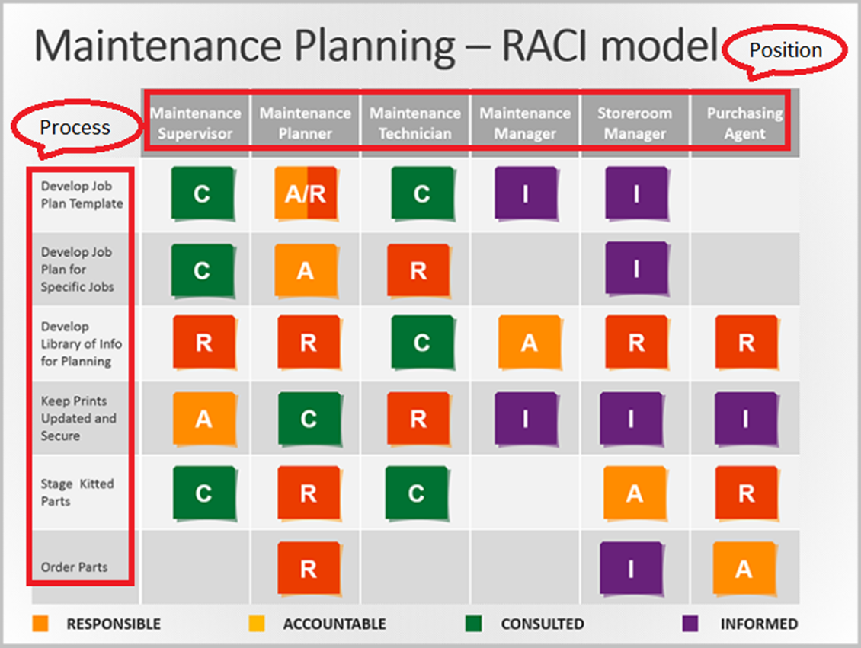
RACI Matrix
Notes:
Facilitator’s Notes:
A RACI Matrix is a visual representation of all the key stakeholders involved in a process and their particular role within that process. The letter assigned (R, A, C or I) determines the level of responsibility specific roles have within the process and what level of engagement each role has in any future decisions made with regard to that process. A RACI Matrix template should contain:
The process
The position involved with that process
The number of people that are involved with a specific business process
What their role is in the process - Responsible? Accountable? Consulted? Informed?

Slide 12

Case Study 1
Sunder works in the procurement and subcontracts organization and is eager to prove himself.
He understands that safety and quality are values on the Waste Treatment Plant Project and is committed to upholding both.
Today, he was called into his manager’s office. Sunder has made a significant mistake in a document that could set back the award of an important subcontract by several weeks.
He became defensive as his manager pointed out the mistake. Sunder does not remember seeing the mistake when he reviewed the document before sending.
Questions:
1.A. What did Sunder do wrong?
1.B. What are Sunder's options to overcome this situation?
Notes:
Facilitator’s Notes:
Discuss the cases with your group
Question 1.A. What did Sunder do wrong?
Answer 1.A.
1. Made a significant mistake in a document
2. Because of his mistake, the award of an important subcontract can set back by several weeks
3. Became defensive as his manager pointed out the mistake, instead of accepting the mistake
4. Carelessly reviewed the document and does not remember seeing the mistake
Question 1.B. What are Sunder's options to overcome this situation?
Answer 1.B.
1. Accept the mistake and regret
2. Learn from past mistakes and rectify it
3. Accept feedback given by manager and acknowledge the mistakes done
4. Take full ownership of the responsibility now and also in future

Slide 13
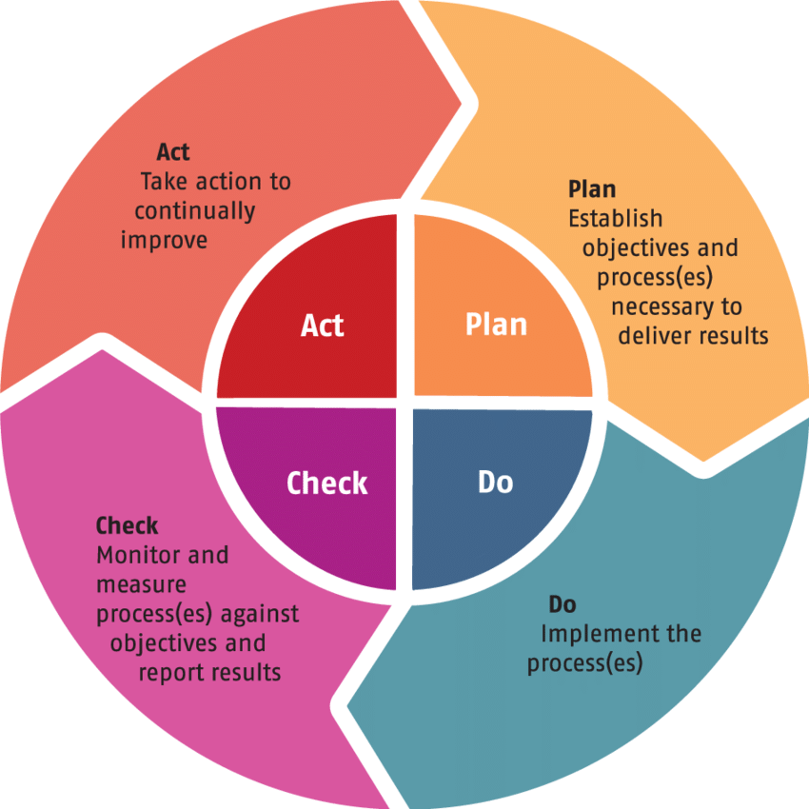
PDCA (Plan - Do - Check - Action) Cycle
Notes:
Facilitator’s Notes:
Say: The concept of PDCA (Plan - Do - Check - Action) was made popular by the Quality Guru, Edward Deming. It is probably one of the simplest yet most effective concepts that can be used as a good working habit. In a way, it only wakes up one’s common sense to go through a task professionally and correctly.
This involves –
(1) “Planning” for a task,
(2) “Doing” the task
(3) “Checking” the results of your task and identifying any deviations, issues, bottlenecks, improvement points and
(4) “Act” to clear the check points of stage 3. Following this cycle will lead to Continuous Improvement.
Effective usage of one’s day to day diary is actually following PDCA. One should be encouraged to plan his day’s activities.
He then goes through the activities and keeps a check for action points. Such a habit provides for a structured and automated way of working and also eliminates wastage of resources. It brings a sense of ownership towards one’s work.

Slide 14
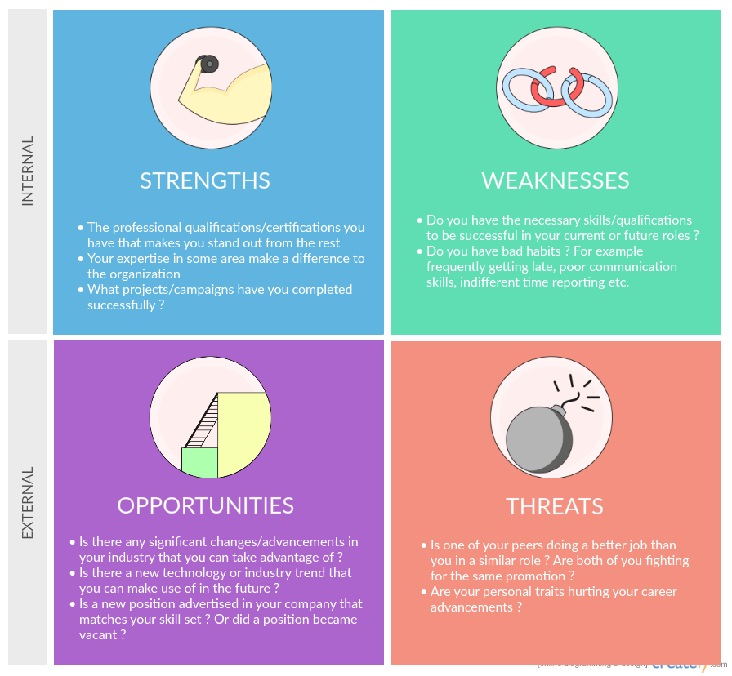
Personal SWOT (Strengths, Weakness, Opportunities & Threat) Analysis
Notes:
Facilitator’s Notes:
Sample Personal SWOT (strengths, weakness, opportunities and threat) analysis
Personal Swot Analysis is a method of evaluating an individual's strengths and weaknesses relating to personal goals. It is a way of determining your own SWOT (strengths, weaknesses, opportunities, threats) for personal growth. Personal swot analysis offers a lot of benefits for your career path and progression. So, why do you need to do a personal SWOT analysis, or what are some of its essential benefits?
Trainer to spend some time in helping the participants understand SWOT. Ask the participants to give some examples of SWOT

Slide 15





98752-08472
Hello@freelancetrainings.com
www.freelancetrainings.com
406, Titanium City Centre Mall, Anand Nagar, Satellite, Ahmedabad-380015

