Slide 1

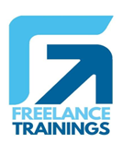
Interviewing Skills for Managers
Your
Company
Logo
Notes:
Note for the trainer: start the day with enthusiasm. Your enthusiasm should reflect in your tone of voice and body language.
Good morning everyone!
How are you today. Are you ready to dive into a day of learning, growth, and transformation? I know I am!
Today, we have a unique opportunity to learn from each other, challenge ourselves, and take our personal and professional lives to the next level. Today’s workshop is highly engaging, filled with activities, role plays, videos and discussions that are designed to inspire and empower you.
But this isn't going to be a passive experience. This isn't a lecture where you sit back and listen to someone else talk. This is an interactive, dynamic, and engaging workshop that requires your full participation, your curiosity, and your willingness to learn.
Throughout the day, you'll have the chance to connect with other like-minded individuals, share your own experiences and insights, and gain new skills and knowledge that will help you achieve your goals. You'll be challenged, pushed outside your comfort zone, and supported every step of the way.
So, are you ready to embrace this day with open hearts and open minds? Are you ready to learn, grow, and transform? I know I am, and I can't wait to see what we'll achieve together.
Let's get started!

Slide 2

Workshop Agenda
Module-1 -Understanding the art of Interviewing
Module-2 -Knowing Who you want?
Module-3 -Pre Interview Preparation
Module-4 -During Interview Part-1
Module-5 -During Interview Part-2
Module-6 -Post Interview/ After Interview
Module-7 -Other Important Points
Notes:
Welcome to the Interviewing Techniques Workshop Program. Are you excited for today`s workshop? let me introduce todays workshop modules.
Understanding the art of Interviewing
Knowing Who you want?
Pre Interview Preparation
During Interview Part-1
During Interview Part-2
Post Interview/ After Interview
Other Important Points
Move to next slide

Slide 3

What is Interviewing?
Process of assessing candidates to determine their suitability for a particular job or role within the organization. Key aspects of interviewing include.
Assessing Qualifications
Evaluating Fit
Gathering Information
Decision-Making
Notes:
Interviewing is a structured and systematic process of conducting conversations with individuals to gather information, assess qualifications, and make decisions. It is commonly used in various contexts, including job recruitment, journalism, research, and information gathering
Key aspects of interviewing in the HR and job recruitment context include:
Assessing Qualifications: Interviewers aim to evaluate a candidate's qualifications, skills, experience, and knowledge relevant to the position they are applying for.
Evaluating Fit: Interviewers also assess whether a candidate's personality, values, and work style align with the company culture and the specific requirements of the job.
Gathering Information: Interviews serve as a means to collect additional information beyond what is available on a candidate's resume or application, allowing interviewers to delve deeper into a candidate's background and qualifications.
Decision-Making: Interviewers use the information gathered during interviews to make informed hiring decisions, including selecting the best-suited candidate for the position.

Slide 4


Interviewing Art / Science
Artistic Aspect:
Interpersonal Skills
Intuition and Judgment
Scientific Aspect:
Structured Approach
Data Collection and Analysis
Psychometrics
Notes:
Interviewing is both an art and a science. It combines elements of both artistry and scientific methodology. Here's why:
Artistic Aspect:
Interpersonal Skills: Successful interviewing often requires strong interpersonal skills, including active listening, empathy, and the ability to build rapport with the interviewee. These skills are subjective and can be considered an art because they involve human interaction and communication, which can vary greatly from one interviewer to another.
Intuition and Judgment: Interviewers often rely on their intuition and judgment to assess the interviewee's responses, body language, and overall suitability for a role. These subjective assessments are more art than science.
Scientific Aspect:
Structured Approach: Many interviews, especially in professional settings like job interviews, benefit from a structured and systematic approach. This includes using standardized questions, evaluation criteria, and rating scales. Such methods are rooted in scientific principles.
Data Collection and Analysis: Interviews are a method of data collection, and the data collected can be analyzed systematically to make informed decisions. This data-driven aspect is a scientific component of interviewing.
Psychometrics: Some interview techniques, such as behavioral interviews, use psychometric principles to assess an individual's past behavior as an indicator of future performance. These methods involve a scientific foundation.
In summary, successful interviewing requires a balance between the art of human interaction and the science of systematic data collection and analysis. While the interpersonal skills and judgment of the interviewer contribute to the artistry, the structured methods, data-driven decision-making, and scientific principles involved in the process contribute to its scientific aspect. Therefore, interviewing is best seen as an integration of both art and science, with the exact blend varying depending on the context and purpose of the interview.

Slide 5
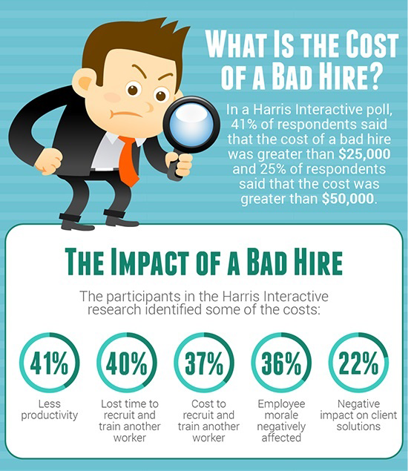
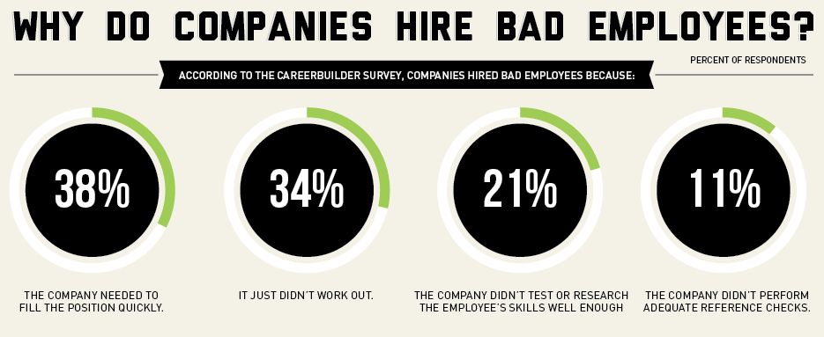
Understanding the cost of Bad hire
Notes:
Fact of the cost of Bad hire

Slide 6
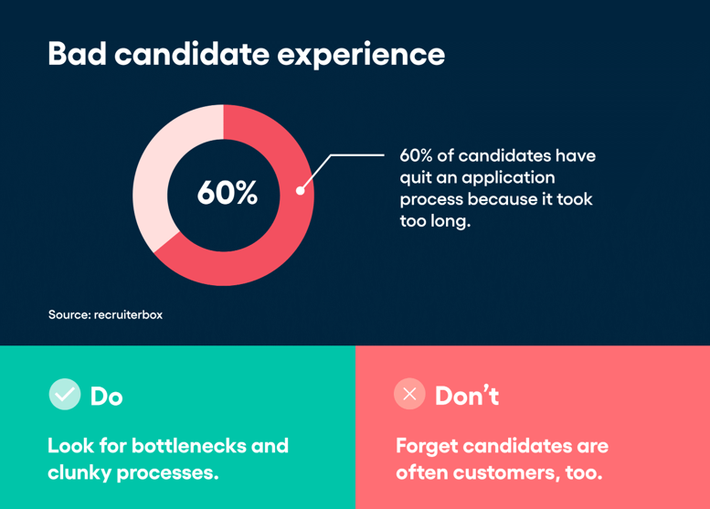
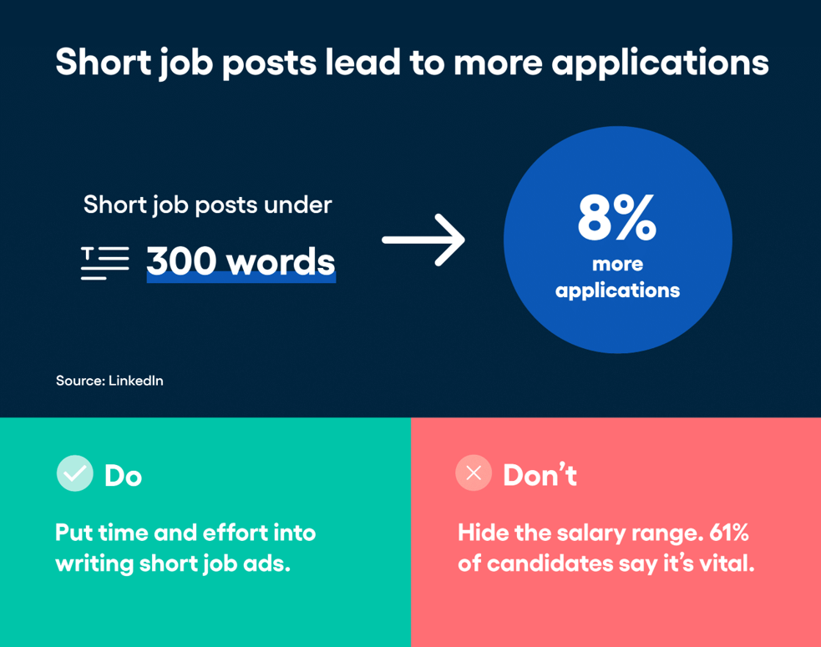
Facts Relating To Interviewing
Notes:
Facts Relating To Interviewing

Slide 7

Interviewing Myths
The best candidate is the one with the most experience
While experience can be important, it's not the sole determinant of a candidate's suitability
Gut feeling is a reliable indicator of a candidate's potential.
Relying solely on intuition can lead to bias and subjective decision-making..
Technical skills are all that matter in a candidate's evaluation.
Soft skills such as communication, teamwork, problem-solving, and adaptability are equally important, if not more so, for a candidate's success in most roles.
A long interview process always leads to better hires
While thoroughness is important, an excessively lengthy interview process can deter qualified candidates and prolong time-to-hire.
First impressions are always accurate
While first impressions can provide initial insights, they're not always accurate indicators of a candidate's capabilities or suitability for the role.
Notes:
Myth: The best candidate is the one with the most experience.
Explanation: While experience can be important, it's not the sole determinant of a candidate's suitability. Other factors such as skills, cultural fit, and potential for growth are equally crucial.
Myth: Gut feeling is a reliable indicator of a candidate's potential. Explanation: Relying solely on intuition can lead to bias and subjective decision-making. It's essential to base hiring decisions on concrete evidence, such as qualifications, past performance, and behavioral assessments.
Myth: Technical skills are all that matter in a candidate's evaluation. Explanation: Soft skills such as communication, teamwork, problem-solving, and adaptability are equally important, if not more so, for a candidate's success in most roles.
Myth: A long interview process always leads to better hires. Explanation: While thoroughness is important, an excessively lengthy interview process can deter qualified candidates and prolong time-to-hire. Balancing thoroughness with efficiency is key to attracting top talent and making timely hires.
Myth: First impressions are always accurate. Explanation: While first impressions can provide initial insights, they're not always accurate indicators of a candidate's capabilities or suitability for the role. People may feel nervous during interviews, leading to suboptimal performance. It's essential for managers to delve deeper, ask probing questions, and give candidates the opportunity to showcase their true abilities.

Slide 8


Job Analysis & Job Description
Job analysis is a systematic process of gathering, documenting, and analyzing information about a job or position within an organization.(duties, responsibilities, qualifications, and work environment)
Job description is a written document that provides a concise summary of the key aspects of a specific job or position within an organization.(Formal communication)
Notes:
Job analysis and job description are crucial components of the hiring process, as they help organizations define the qualifications, responsibilities, and expectations associated with a particular job role
Job analysis is a systematic process of gathering, documenting, and analyzing information about a job or position within an organization. The primary goal of job analysis is to provide a detailed understanding of the duties, responsibilities, qualifications, and work environment associated with a specific job. Here are key aspects of job analysis:
A job description is a written document that provides a concise summary of the key aspects of a specific job or position within an organization. It serves as a formalized way to communicate job-related information to both current employees and potential candidates

Slide 9
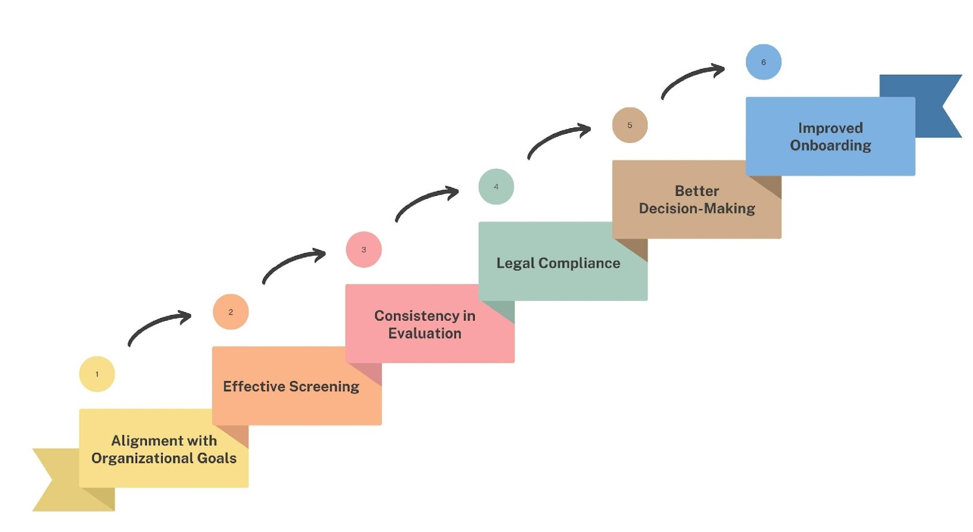
Defining the Criteria
Notes:
Defining the criteria for what makes a great candidate to hire is a crucial step in the recruitment process. It ensures that the hiring team has a clear understanding of the qualifications, skills, and attributes needed for success in the specific job role and within the organization
Following are the key benefits of defining the criteria
Alignment with Organizational Goals: Clearly defining the criteria for a great candidate helps ensure that the hiring process aligns with the organization's strategic goals and objectives. It ensures that new hires contribute positively to the company's mission and vision.
Effective Screening: With well-defined criteria, the hiring team can efficiently screen applications and resumes. This saves time and resources by focusing on candidates who closely match the job requirements.
Consistency in Evaluation: Having established criteria ensures consistency in evaluating candidates. Multiple interviewers or panel members can assess candidates using the same set of standards, reducing bias and subjectivity in the hiring process.
Legal Compliance: Defining the criteria helps ensure that the hiring process complies with legal and ethical guidelines. It helps avoid discriminatory practices and ensures that hiring decisions are based on job-related factors.
Better Decision-Making: When hiring criteria are clear, the hiring team is more likely to make well-informed decisions about which candidates are the best fit for the organization. This leads to better hiring outcomes.
Improved Onboarding: Hiring managers can use the defined criteria to create tailored onboarding plans for new hires. This helps new employees integrate into their roles more effectively and contribute to the organization from day one.
To define what makes a great candidate to hire, organizations typically create job descriptions and job specifications that outline the necessary qualifications, skills, experience, and personal attributes. These documents serve as a reference point throughout the recruitment process, from drafting job advertisements to conducting interviews and making final selections.
It's also essential for hiring teams to engage in collaboration and discussion to ensure that the criteria reflect not only the technical requirements of the job but also the cultural fit and values alignment with the organization. This holistic approach helps identify candidates who not only have the required skills but are also likely to thrive within the company's culture and contribute positively to its long-term success.

Slide 10

Stages in the Interview
Pre-Interview
During Interview
Post-Interview
Notes:
An interview process typically consists of three key stages:
Pre-Interview,
During the Interview
Post-Interview.
Each stage serves a specific purpose in assessing and selecting candidates.

Slide 11

Screening the Applications
Review Resumes
Assess Cover Letters
Use Screening Criteria
Eliminate Unqualified Candidates
Rank Candidates
Collaborate with Hiring Managers
Notes:
Screening Applications:
Review Resumes: Begin by reviewing the resumes of applicants. Pay attention to qualifications, relevant work experience, education, skills, and certifications. Ensure that candidates meet the basic job requirements.
Assess Cover Letters: Evaluate cover letters for candidates' motivations, alignment with the company, and any additional information they provide about their qualifications and experiences. Look for customized cover letters that demonstrate genuine interest in the role.
Use Screening Criteria: Develop a set of screening criteria or a checklist based on the job description and requirements. This helps in objectively evaluating candidates and ensures consistency in the screening process.
Eliminate Unqualified Candidates: Disqualify candidates who do not meet the minimum qualifications or whose application materials indicate a lack of alignment with the role. This step streamlines the applicant pool.
Rank Candidates: Consider ranking or categorizing candidates into different groups, such as "strong fit," "possible fit," and "not a fit." This helps prioritize which candidates to move forward in the process.
Collaborate with Hiring Managers: Collaborate closely with hiring managers to align on the screening criteria and to ensure that the selected candidates match the department's needs.
Receiving and screening applications effectively sets the stage for a successful recruitment process by identifying candidates who meet the initial qualifications and are a good fit for the organization. It's a crucial step in narrowing down the candidate pool and moving forward with interviews and further assessments.

Slide 12




Importance of Asking Right Questions
Adaptability
Clarity and Understanding
Learning and Development
Gathering Information
Effective Communication
Notes:
Asking the right questions is a fundamental aspect of effective communication, problem-solving, decision-making, and information gathering. In various contexts, including job interviews, meetings, research, and everyday interactions, the importance of asking the right questions cannot be overstated.
In the context of interviews, asking the right questions is essential for evaluating candidates, assessing their qualifications, and determining cultural fit. It ensures that hiring decisions are based on relevant criteria.
Here are some key reasons why asking the right questions is essential:
Clarity and Understanding: Asking well-structured and relevant questions helps clarify thoughts and ideas. It ensures that both the questioner and the respondent have a clear understanding of the topic or issue at hand.
Gathering Information: Whether conducting research, interviewing candidates, or collecting data, asking the right questions is essential for obtaining accurate and useful information. It helps in making informed decisions.
Effective Communication: Asking well-phrased questions can enhance communication by facilitating a clear exchange of ideas and information. It minimizes misunderstandings and misinterpretations.
Learning and Development: Effective questioning is a key component of learning and skill development. It encourages individuals to seek knowledge, explore new ideas, and deepen their understanding of various subjects.
Adaptability: Asking the right questions enables individuals and organizations to adapt to changing circumstances and environments. It promotes agility and the ability to respond effectively to challenges.
In summary, asking the right questions is a versatile and powerful skill that underpins effective communication, decision-making, problem-solving, and personal development. It promotes clarity, understanding, and meaningful interactions, ultimately leading to better outcomes in both professional and personal contexts.

Slide 13
Assessing the resume- Finding Common Clues
Date: Is the CV current?
Education background: Relevance and appropriateness
Career objectives: Are they consistent with the position
you are interviewing
Employment history:
Dates and Gaps
Scope / Dimension, duties, KRAs, Reporting, Level
Career progression and achievements
Reasons for changing jobs
Relevance to current role
Overall organization of resume: Flow, chronological, consistent format,
usage of tables, fonts etc.
Writing style: Clarity, does the candidate present himself effectively?
References: Ideally past supervisors
Completeness: Is it complete in all respects?
Date: 01-04/2023
R Joshi
Address: 23, Savita Sadan, Gokhale Road, Dadar, Mumbai 26
Tel No: 022 – 28765432, 09312345678
Date of Birth: 23/12/1972
Family: Married, Wife works for ABC Bank, Prabhadevi Branch. One son – 3 years old
Education: B Com, MBA
Notes:
Things to look for while Reviewing the resume
Date: Is the CV current?
Education background: Relevance and appropriateness
Career objectives: Are they consistent with the position you are interviewing?
Employment history:
Dates and Gaps
Scope / Dimension, duties, KRAs, Reporting, Level
Career progression and achievements
Reasons for changing jobs
Relevance to current role
Overall organization of resume: Flow, chronological, consistent format, usage of tables, fonts etc.
Writing style: Clarity, does the candidate present himself effectively?
References: Ideally past supervisors
Completeness: Is it complete in all respects?

Slide 14

Put the Candidate at Ease
Greet the candidate
Smile with a friendly welcome
Establish eye contact
Display sincere voice / tone / body language
Introduce yourself and the panel members
Information about your role in the organization & role in the selection process.
Ensure candidate is comfortable & is meeting people of right levels
Notes:
Put the candidate at ease
Greet the candidate
Smile with a friendly welcome
Establish eye contact
Display sincere voice / tone / body language
Introduce yourself and the panel members
Provide adequate information such as role in the organization & role in the selection process.
Ensure candidate is comfortable & is meeting people of right levels

Slide 15

Types of Interview
Structured Interviews
Unstructured Interviews
Involve asking a standardized set of predetermined questions to all candidates.
Standardized Questions
Consistency
Scoring System
Reliability
E,g Can you explain your experience as a Manager in previous organization.
are more flexible and informal, with interviewers asking open-ended questions and exploring various topics as the conversation unfolds
Open-Ended Questions
Flexibility
Subjectivity
Exploration
E.G "Tell me about yourself"
Notes:
Structured and unstructured interviews are two different approaches to conducting job interviews, each with its own set of characteristics and advantages. Here's a brief explanation of each:
Structured Interviews:
Standardized Questions: In structured interviews, the interviewer asks a predetermined set of questions to all candidates. These questions are typically designed to assess specific job-related skills, experiences, and qualifications.
Consistency: Structured interviews aim to provide a consistent and fair experience to all candidates by asking the same questions in the same order. This reduces bias and ensures that each candidate is evaluated using a similar framework.
Scoring System: Often, structured interviews use a scoring system or rubric to objectively evaluate candidates' responses. Each question may be assigned a weight or score, and candidates are assessed based on their answers.
Reliability: Structured interviews tend to have higher reliability because of their standardized approach. This means that the interview process is more consistent, and the results are more dependable.
Examples: A structured interview for a software developer position might include questions like "Can you explain your experience with programming languages X, Y, and Z?" or "Give an example of a sales objection that you have encountered.“
Unstructured Interviews:
Open-Ended Questions: Unstructured interviews involve more open-ended questions that allow for a free-flowing conversation between the interviewer and the candidate. The questions are not predetermined and can vary based on the candidate's responses.
Flexibility: Unstructured interviews are less rigid and offer flexibility in terms of the questions asked. Interviewers can explore different aspects of a candidate's background, experiences, and personality as the conversation unfolds.
Subjectivity: Because questions are not standardized, unstructured interviews can be more subjective. Interviewers may form impressions based on their personal biases or preferences, potentially introducing bias into the evaluation process.
Exploration: Unstructured interviews are useful when you want to delve deeper into a candidate's thought process, creativity, or problem-solving abilities. They can be particularly effective for assessing soft skills and cultural fit.
Examples: An unstructured interview might begin with a general question like "Tell me about yourself" and then evolve based on the candidate's response. Follow-up questions may explore specific experiences, challenges, or hypothetical scenarios.
In summary, structured interviews provide a consistent and standardized way to evaluate candidates, making them suitable for assessing specific job-related skills. Unstructured interviews, on the other hand, allow for more flexibility and in-depth exploration of a candidate's qualities but may be less reliable due to subjectivity. Many organizations use a combination of both structured and unstructured elements in their interview process to gather a comprehensive assessment of candidates.

Slide 16

The Types Of Questions
Elementary Questions
Competency Based Questions
Business/ Performance/ Function Based Questions
Probing Questions
Follow-Up Questions
Closing Questions
Notes:
Lets See different types of questions that the interviewer can ask

Slide 17

STAR Technique
Interviewers can use STAR method to structure their questions and evaluate candidate responses effectively.
Here's how interviewers can apply the STAR technique.
S
Situational Questions
T
Task-Oriented Questions
A
Action-Oriented Questions
R
Result-Oriented Questions
Notes:
The STAR (Situation, Task, Action, Result) technique is not only valuable for candidates but also for interviewers. Interviewers can use the STAR method to structure their questions and evaluate candidate responses effectively. Here's how interviewers can apply the STAR technique in the context of conducting interviews:
Situational Questions:
Formulation: When preparing interview questions, interviewers can craft situational questions that ask candidates to describe a specific scenario they've encountered in the past.
Example: "Can you recall a time when you had to resolve a conflict within your team? Please describe the situation, the task or challenge you faced, the actions you took, and the ultimate result."
Task-Oriented Questions:
Formulation: Interviewers can ask task-oriented questions to understand the candidate's ability to define objectives and responsibilities in various situations.
Example: "Tell me about a project where you had to set clear tasks and objectives for your team. What was the project, what were the specific tasks, how did you assign responsibilities, and what were the expected outcomes?"
Action-Oriented Questions:
Formulation: Interviewers can ask action-oriented questions to assess a candidate's problem-solving skills, decision-making process, and actions taken in specific situations.
Example: "Provide an example of a challenging issue you encountered in your previous role. Describe the actions you took to address it, including any decisions you made and the rationale behind those decisions."
Result-Oriented Questions:
Formulation: Interviewers can inquire about the outcomes of a candidate's actions to gauge their impact on the organization.
Example: "In a past role, you mentioned implementing a new process. Can you share the measurable results or improvements that resulted from this change? How did it benefit your team or the company overall?"
By incorporating the STAR technique into the interview process, interviewers can:
Gain a deeper insight into a candidate's qualifications and experiences.
Evaluate a candidate's problem-solving, decision-making, and communication skills.
Assess a candidate's ability to take initiative and achieve measurable results.
Make informed hiring decisions based on a structured and consistent approach.
Reduce the influence of bias by focusing on concrete examples and results.
Overall, the STAR technique is a valuable tool for interviewers to conduct more effective and thorough interviews, leading to better hiring decisions and a more equitable selection process.

Slide 18

Handling Difficult Candidates & Situations
Stay Calm and Professional
Active Listening
Empathize and Validate
Clarify Expectations
Address Inappropriate Behavior
Redirect the Conversation
Maintain Control of the Interview
Involve Others if Necessary
Debrief with the Team
Notes:
Handling difficult candidates and challenging situations during interviews is a crucial skill for interviewers. Here are some strategies and tips to help you manage such situations effectively:
1. Stay Calm and Professional:
Maintain a calm and professional demeanor throughout the interview, regardless of the candidate's behavior or responses. This sets a positive example and helps de-escalate tension.
2. Active Listening:
Listen attentively to the candidate's responses and concerns. Sometimes, candidates may be frustrated or anxious, and simply giving them an opportunity to express themselves can ease the situation.
3. Empathize and Validate:
Show empathy and validate the candidate's feelings or concerns. Acknowledge their perspective and let them know you understand their point of view.
4. Clarify Expectations:
Clearly communicate the interview process and expectations upfront, including the structure of the interview, the types of questions you will ask, and the evaluation criteria. This can prevent misunderstandings.
5. Address Inappropriate Behavior:
If a candidate exhibits rude, disrespectful, or inappropriate behavior, address it politely but firmly. Let them know that such behavior is not acceptable and may impact their candidacy.
6. Redirect the Conversation:
If a candidate goes off-topic or becomes defensive, gently guide the conversation back to the relevant topics and questions. You can say, "I appreciate your input on that topic. Let's now focus on [specific question]."
7. Maintain Control of the Interview:
As the interviewer, you should maintain control of the interview process. If a candidate monopolizes the conversation or becomes overly dominant, politely interrupt and steer the conversation back on track.
11. Involve Others if Necessary:
If a situation escalates or becomes unmanageable, consider involving a colleague or HR representative to help mediate or provide support.
13. Debrief with the Team:
If the interview involves multiple interviewers, have a debriefing session to discuss challenging interactions and reach a consensus on the candidate's overall fit for the role.
Remember that every candidate is unique, and difficult situations may arise for various reasons. Your ability to handle these situations professionally and constructively is an essential aspect of effective interviewing. Ultimately, the goal is to make informed hiring decisions while maintaining a positive and respectful interview experience for all candidates.

Slide 19

Examples -Rating and Ranking Candidates Objectively
1. Qualifications and Skills: Rate candidates on a scale (e.g., 1 to 5) for their qualifications and skills relevant to the job.
For example:
Candidate A: 4/5
Candidate B: 3/5
Candidate C: 5/5
4. Interview Performance: Evaluate candidates' performance in the interview based on predefined criteria, such as responses to behavioral questions or technical assessments.
For example:
Candidate A (Interview Performance): 4/5
Candidate B (Interview Performance): 3/5
Candidate C (Interview Performance): 5/5
2. Behavioral Competencies: Assess candidates on behavioral competencies using specific criteria, such as communication skills, teamwork, or problem-solving.
For example:
Candidate A: (Communication Skills): 4/5
Candidate B: (Teamwork): 3/5
Candidate C: (Problem-Solving): 5/5
5. Ranking: Rank candidates based on their interview performance ratings.
For example:
Candidate C
Candidate A
Candidate B
3. Cultural Fit: Evaluate candidates' alignment with the company’s culture and values. Use a rating scale to assess their fit. For example:
For example:
Candidate A: 3/5
Candidate B: 4/5
Candidate C: 5/5
6 Overall Assessment: Combine ratings from different criteria (e.g.,, qualifications, behavioral competencies, cultural fit, interview performance) to create an overall assessment score.
For example:
Candidate A (Overall Assessment): 16/20
Candidate B (Overall Assessment): 14/20
Candidate C (Overall Assessment): 18/20
Notes:
Rating and ranking candidates objectively involves assessing their qualifications and fit for a role based on predetermined criteria. Here are some examples of how you can rate and rank candidates objectively:
1. Qualifications and Skills:
Rating: Rate candidates on a scale (e.g., 1 to 5) for their qualifications and skills relevant to the job. For example:
Candidate A: 4/5
Candidate B: 3/5
Candidate C: 5/5
Ranking: Based on their ratings, rank candidates from the highest to the lowest score. For example:
Candidate C
Candidate A
Candidate B
2. Behavioral Competencies:
Rating: Assess candidates on behavioral competencies using specific criteria, such as communication skills, teamwork, or problem-solving. For example:
Candidate A (Communication Skills): 4/5
Candidate B (Teamwork): 3/5
Candidate C (Problem-Solving): 5/5
Ranking: Rank candidates based on their scores for each competency. For example:
Candidate C (Problem-Solving)
Candidate A (Communication Skills)
Candidate B (Teamwork)
3. Cultural Fit:
Rating: Evaluate candidates' alignment with the company's culture and values. Use a rating scale to assess their fit. For example:
Candidate A (Cultural Fit): 3/5
Candidate B (Cultural Fit): 4/5
Candidate C (Cultural Fit): 5/5
Ranking: Rank candidates based on their cultural fit scores. For example:
Candidate C
Candidate B
Candidate A
4. Interview Performance:
Rating: Evaluate candidates' performance in the interview based on predefined criteria, such as responses to behavioral questions or technical assessments. For example:
Candidate A (Interview Performance): 4/5
Candidate B (Interview Performance): 3/5
Candidate C (Interview Performance): 5/5
5. Ranking: Rank candidates based on their interview performance ratings. For example:
Candidate C
Candidate A
Candidate B
6. Overall Assessment:
Rating: Combine ratings from different criteria (e.g., qualifications, behavioral competencies, cultural fit, interview performance) to create an overall assessment score. For example:
Candidate A (Overall Assessment): 16/20
Candidate B (Overall Assessment): 14/20
Candidate C (Overall Assessment): 18/20
These examples demonstrate how you can use a rating and ranking system to objectively assess candidates' qualifications, skills, competencies, and fit for a specific role. The key is to establish clear criteria and consistently apply them to all candidates, ensuring a fair and impartial evaluation process.

Slide 20

Red Flags & Warning Signs
Post-interview, it's essential to be vigilant for red flags and warning signs that may indicate potential issues with a candidate
Inconsistencies in Responses
Lack of Enthusiasm or Interest
Negative Attitude
Limited Knowledge of the Company
Overemphasis on Compensation
Inability to Provide Examples
Poor Communication Skills
Unprofessional Behavior
Limited Questions or Curiosity
Gaps in Employment
Overconfidence or Arrogance
Short Tenure in Previous Roles
Notes:
Post-interview, it's essential to be vigilant for red flags and warning signs that may indicate potential issues with a candidate or aspects of the hiring process. These flags can help you make more informed decisions and avoid potential pitfalls. Here are some common red flags to watch for:
1. Inconsistencies in Responses:
If a candidate provides inconsistent answers during different stages of the interview process or contradicts information on their resume, it may indicate dishonesty or a lack of integrity.
2. Lack of Enthusiasm or Interest:
If a candidate displays minimal enthusiasm, interest, or engagement during the interview, it could suggest a lack of genuine interest in the role or organization.
3. Negative Attitude:
Candidates who consistently exhibit a negative attitude, criticize former employers, or speak negatively about colleagues may bring a negative atmosphere to the workplace.
4. Limited Knowledge of the Company:
If a candidate has not taken the time to research your organization or seems unfamiliar with your company's mission, values, or products/services, it may indicate a lack of genuine interest.
5. Overemphasis on Compensation:
A strong focus on compensation and benefits rather than the role, responsibilities, or career growth within the company may suggest a candidate is primarily motivated by money.
6. Inability to Provide Examples:
If a candidate struggles to provide specific examples of their achievements, skills, or experiences, it could indicate a lack of relevant qualifications or potentially exaggerated claims.
7. Poor Communication Skills:
Candidates who have difficulty articulating their thoughts, providing clear responses, or demonstrating effective communication skills may struggle in roles that require strong communication abilities.
8. Unprofessional Behavior:
Any unprofessional behavior, such as arriving late for the interview, failing to follow up with thank-you notes, or displaying rudeness, can raise concerns about a candidate's professionalism.
9. Limited Questions or Curiosity:
Candidates who do not ask thoughtful questions about the role, team, or company may lack genuine curiosity or engagement in the opportunity.
10. Gaps in Employment: - Significant unexplained gaps in a candidate's employment history may raise concerns about consistency, reliability, or the ability to hold a job.
11. Overconfidence or Arrogance: - Excessive self-confidence or arrogance that comes across as dismissive or unwilling to collaborate with others can be detrimental to team dynamics.
12. Short Tenure in Previous Roles: - Frequent job changes or a history of short tenures at previous employers may indicate a candidate's lack of commitment or inability to thrive in a stable work environment.
It's important to note that one red flag alone may not necessarily disqualify a candidate. Instead, consider these flags as potential warning signs that warrant further investigation or discussion with the candidate. Conducting thorough reference checks, seeking additional information, and having candid discussions can help you make more informed hiring decisions while mitigating potential risks.
Regenerate

Slide 21






Thanks for Participation
98752-08472
Hello@freelancetrainings.com
www.freelancetrainings.com
406, Titanium City Centre Mall, Anand Nagar, Satellite, Ahmedabad-380015

